Slide 1



Unit - 3
Machine Learning

Slide 2
Chapters for Discussion
Chapter - 1
Introduction – Machine Learning – Supervised, Unsupervised ML
Chapter - 2
Linear Machine learning model
Chapter - 3
Non-Linear Model

Slide 3

Chapter
Linear Machine learning model
2

Slide 4


DISCLAIMER
The content is curated from online/offline resources and used for educational purpose only.

Slide 5

Learning Objectives
Differentiate between classification and regression techniques and identify how each can be applied to sustainability-focused projects.
Describe real-world examples of supervised learning applications in sustainability, such as predicting energy consumption, classifying waste types, and monitoring biodiversity.
Understand the significance of error metrics (e.g., RMSE, MAE) in regression analysis and interpret their relevance for environmental forecasting.
Develop and apply regression models to predict sustainability-related outcomes, such as energy consumption, greenhouse gas emissions, or crop yields.
Evaluate the performance of supervised learning models using appropriate metrics (e.g., accuracy, precision, recall) and interpret the results in the context of environmental or sustainability goals.
Build classification models to categorize sustainability-related data, such as classifying areas of biodiversity risk, types of waste, or pollution levels.
GOAL
Notes:
Lets, discuss about Learning objectives,
Differentiate between classification and regression techniques and identify how each can be applied to sustainability-focused projects.
Describe real-world examples of supervised learning applications in sustainability, such as predicting energy consumption, classifying waste types, and monitoring biodiversity.
Understand the significance of error metrics (e.g., RMSE, MAE) in regression analysis and interpret their relevance for environmental forecasting.
Develop and apply regression models to predict sustainability-related outcomes, such as energy consumption, greenhouse gas emissions, or crop yields.
Evaluate the performance of supervised learning models using appropriate metrics (e.g., accuracy, precision, recall) and interpret the results in the context of environmental or sustainability goals.
Build classification models to categorize sustainability-related data, such as classifying areas of biodiversity risk, types of waste, or pollution levels.

Slide 6
Regression
In simple terms, regression helps you estimate the relationship between variables. For example, you might want to predict the price of a house based on its size, number of rooms, and location. Here, the house price is the dependent variable, and the other attributes are independent variables.
Notes:
Regression analysis is a statistical method for modeling the relationship between a dependent variable (target) and one or more independent variables (features). It's widely used in predictive analytics, machine learning, and statistics to understand trends, make predictions, and find insights

Slide 7
Regression
Types of Regression
There are various types of regression techniques, each serving specific needs and assumptions:
Simple Linear Regression
Multiple Linear Regression
Polynomial Regression
Logistic Regression
Ridge, Lasso, and Elastic Net Regression
Notes:
Types of Regression
There are various types of regression techniques, each serving specific needs and assumptions:
Simple Linear Regression: Examines the relationship between two variables (one independent and one dependent). It fits a straight line (linear function) to the data.
Multiple Linear Regression: Extends simple linear regression by including multiple independent variables to predict the target variable.
Polynomial Regression: Captures non-linear relationships by using polynomial terms (squared, cubed terms) of the independent variables.
Logistic Regression: Though technically a classification algorithm, it uses regression principles for binary or multi-class classification.
Ridge, Lasso, and Elastic Net Regression: Regularized versions of linear regression that handle multicollinearity and reduce overfitting by adding penalty terms.

Slide 8

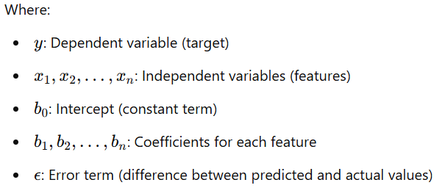
Regression
Mathematics Behind Regression
The general formula for linear regression is
Notes:
Mathematics Behind Regression helps you estimate the relationship between variables. For example, you might want to predict the price of a house based on its size, number of rooms, and location.

Slide 9
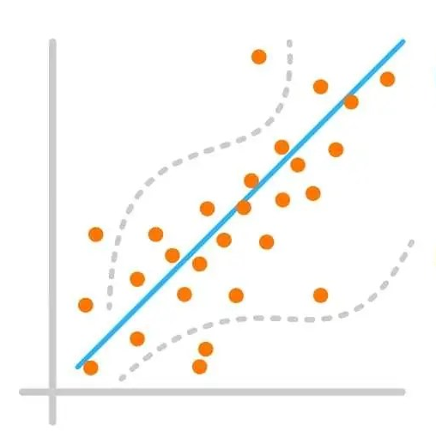
Regression Model Evaluation
Type of Regression Performance Metrics
Mean Absolute Error (MAE)
Mean Squared Error (MSE)
Root Mean Squared Error (RMSE)
R-Squared (R²)
Adjusted R-Squared
Notes:
Regression Model Evaluation
Evaluating regression models is crucial to understanding how well they predict target values. Several metrics provide insights into model accuracy, error distribution, and generalizability.
Type of Regression Performance Metrics
Mean Absolute Error (MAE)
Mean Squared Error (MSE)
Root Mean Squared Error (RMSE)
R-Squared (R²)
Adjusted R-Squared
Evaluating these metrics helps balance model complexity and predictive accuracy, guiding improvements and selecting the best model for the data.

Slide 10
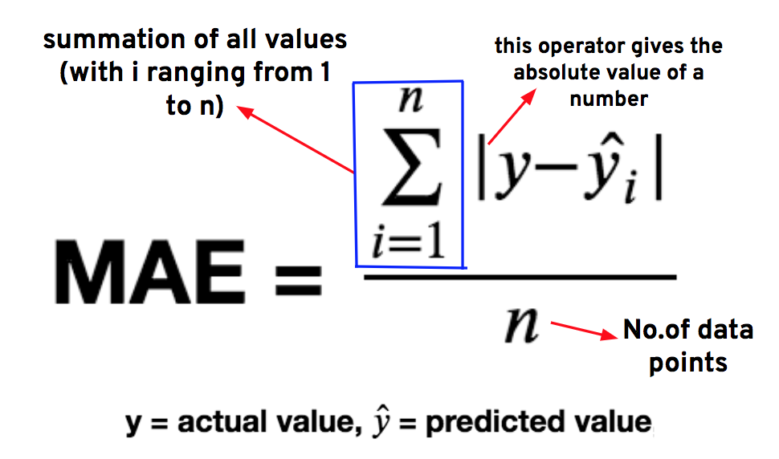
Regression Model Evaluation
Mean Absolute Error (MAE)
Notes:
Mean Absolute Error (MAE) is a widely used metric for evaluating regression models, as it measures the average magnitude of errors between actual values and predicted values without considering their direction. MAE provides an intuitive sense of the average size of errors in the same units as the target variable, making it easy to interpret in real-world applications.
MAE calculates the average of the absolute differences (errors) between each actual and predicted value. By using absolute values, MAE avoids cancelling out positive and negative errors, making it a straightforward measure of prediction accuracy.
Example, MAE is measured in the same units as the target variable, it directly shows the average "distance" between predictions and actual values. For example, if MAE for a house price prediction model is ₹5,000, it means predictions are off by ₹5,000 on average.

Slide 11
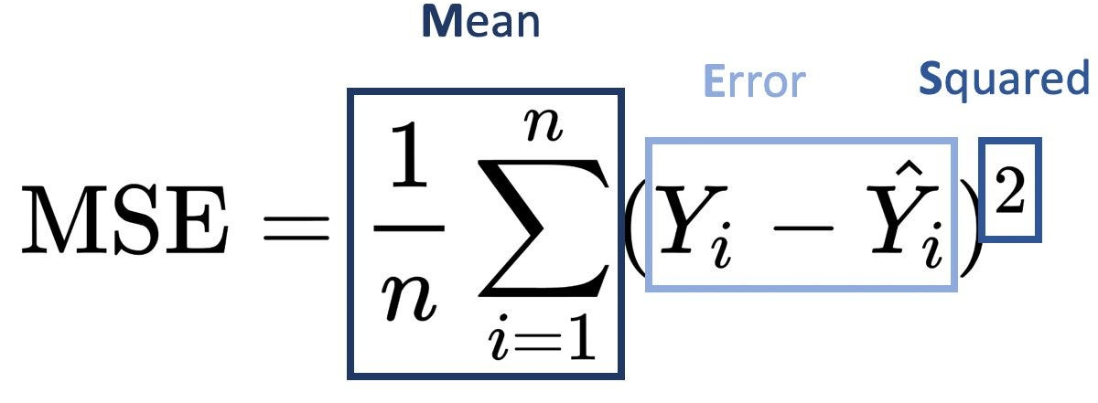
Regression Model Evaluation
Mean Squared Error (MSE)
Notes:
Mean Squared Error (MSE) is a fundamental metric in regression analysis that measures the average squared difference between actual and predicted values. It gives a sense of how far off predictions are from the actual outcomes, providing insight into model accuracy.
Each difference y_{i}​−y_{i}​^ is squared to emphasize larger errors and prevent negative and positive errors from canceling each other out. Squaring the errors also has the effect of penalizing larger errors more heavily, making MSE particularly useful when you want a model to avoid large deviations.
Interpretation of MSE, is a lower MSE indicates that predictions are close to actual values, implying a well-fitting model. However, since MSE is in squared units of the target variable, it can be challenging to interpret in the original units. For this reason, some analysts prefer the Root Mean Squared Error (RMSE), which is the square root of MSE and brings the error back to the original scale.
Note, When comparing multiple regression models, the model with the lower MSE is typically preferred. However, it’s essential to balance this with other metrics (e.g., R-Squared, MAE) and ensure that the model isn’t overfitting to the training data.

Slide 12
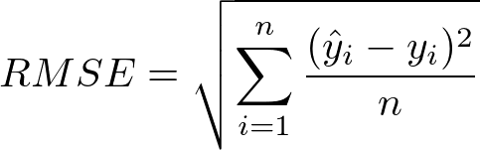
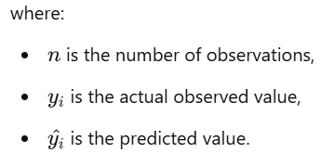
Regression Model Evaluation
Root Mean Squared Error (RMSE)
Root Mean Squared Error (RMSE) is a commonly used metric in regression analysis that measures the average magnitude of error in predictions, expressed in the same units as the target variable. RMSE is calculated by taking the square root of the Mean Squared Error (MSE), which is the average of the squared differences between predicted values (y^) and actual values (y)
Notes:
RMSE is valuable because it penalizes larger errors more than smaller ones. Since it squares the differences, large errors are amplified, making RMSE especially useful when large deviations from actual values are critical. For example, in applications where precise predictions are crucial (like weather forecasting or financial modeling), RMSE helps highlight how far off predictions can be, emphasizing the impact of outliers.
Interpreting RMSE, Since RMSE is expressed in the same units as the dependent variable, it’s directly interpretable. A lower RMSE value indicates better model performance, as it suggests the predictions are closer to actual values. However, RMSE’s interpretation depends on the context of the data and the target variable’s range; what is considered a "good" RMSE can vary greatly. For instance, an RMSE of 10 might be excellent in predicting house prices in millions but inadequate if predicting scores between 0 and 100.

Slide 13
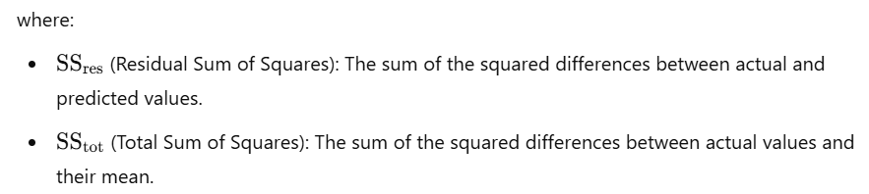

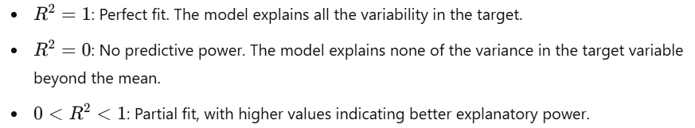
Regression Model Evaluation
R-Squared (R²)
Notes:
R-Squared (R²), also known as the coefficient of determination, is a key metric in regression analysis that measures the proportion of the variance in the dependent variable (target) that can be explained by the independent variables (features). In simpler terms, R² indicates how well the model's predictions align with the actual data points.
By dividing the unexplained variance (SS_{res}​) by the total variance (SS_{tot}​), we get a fraction that indicates how much of the variation in the target variable remains unaccounted for by the model. Subtracting this fraction from 1 yields R², which represents the explained proportion of variance.

Slide 14

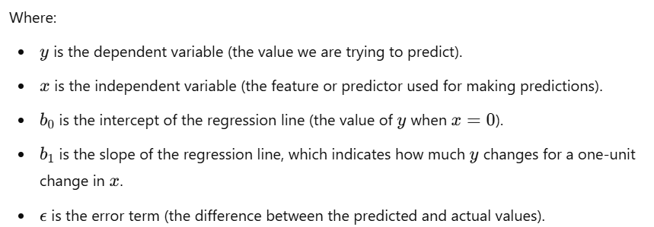
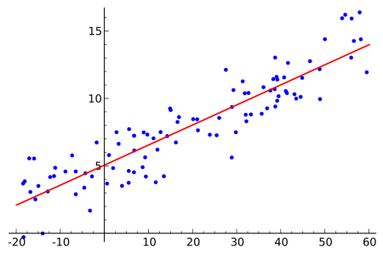
Understanding and Implementation of Simple Linear Regression
Understanding of Simple Linear Regression
The formula for simple linear regression is expressed as:
Notes:
Simple Linear Regression (SLR) is one of the most basic forms of regression analysis, used to model the relationship between two variables. It is a statistical technique that analyzes the relationship between one independent variable (predictor) and one dependent variable (response). The goal is to find the best-fitting straight line that describes this relationship. This line is known as the regression line.
The main objective of SLR is to find the line that best fits the data. This is typically achieved by minimizing the sum of squared residuals (errors). The residual for each data point is the difference between the observed value of y and the predicted value. The line with the smallest sum of squared residuals provides the best model for predicting y based on x.
While simple linear regression is easy to implement and interpret, it has limitations:
It assumes a linear relationship, which may not always be the case. For non-linear relationships, more complex models like polynomial regression might be more appropriate.
It only works with one independent variable. If there are multiple predictors, multiple linear regression is needed.

Slide 15
Understanding and Implementation of Simple Linear Regression
Implementation Simple Linear Regression
Problem Statement
Load Dataset
Data Preprocessing
Define Features and Target
Split the Data into Training and Testing Sets
Create and Train the Simple Linear Regression Model
Make Predictions
Evaluate the Model
Visualize the Results
Save the Model (Optional)
Classroom Hands-on
1. Simple Linear Regression
Notes:
Click Class Room Activity link (then implement and explain the code) Added only SLR if needs MLR you can refer handbook.
To implement Simple Linear Regression for predicting appliance energy consumption, you would follow a typical regression process, where you use features such as temperature, humidity, or time of day to predict energy consumption values.
In this implementation, we used Simple Linear Regression to predict energy consumption based on temperature. By training the model and evaluating its performance using Mean Squared Error and R-Squared, we can assess how well the model fits the data. This method can be extended to include more complex features or used with larger datasets for more robust energy predictions.

Slide 16
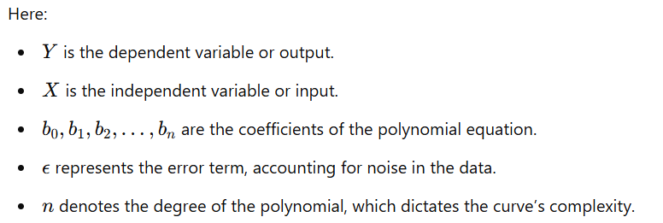
Understand and Implementation of Polynomial Regression
Understanding of Polynomial Regression
The polynomial regression model can be expressed as,
Notes:
Polynomial regression is an extension of linear regression, where the relationship between the independent variable (input) and the dependent variable (output) is modeled as an nth-degree polynomial rather than a straight line. This technique is helpful for capturing more complex, non-linear relationships between variables, making it valuable for a variety of applications, from predicting trends to analyzing data that follows a curved pattern.
At its core, polynomial regression aims to model the relationship between the predictor X and the response Y by fitting a polynomial equation of degree n to the data. While linear regression only captures a linear trend (straight line), polynomial regression can capture curves and bends in the data.

Slide 17
Understanding and Implementation of Polynomial Regression
Implementation Polynomial Regression
Problem Statement
Import Libraries
Load Dataset
Prepare Data
Apply Polynomial Features
Train Polynomial Regression Model
Predictions
Evaluate the Model
Visualize the Results
Classroom Hands-on
2. Polynomial Regression
Notes:
Click Class Room Activity link (then implement and explain the code)
The goal of this project is to predict the CO₂ emissions for a given year based on several factors: total energy consumption, the percentage of energy derived from renewable sources, and the Gross Domestic Product (GDP). This problem uses Polynomial Regression to model the non-linear relationships between the independent variables (energy consumption, renewable energy percentage, and GDP) and the dependent variable (CO₂ emissions).
With growing concerns about environmental sustainability and climate change, predicting and understanding the sources of CO₂ emissions is crucial. The energy consumption patterns, renewable energy adoption, and economic indicators such as GDP play significant roles in determining the overall CO₂ emissions in a country. Accurate prediction models can assist policymakers, businesses, and environmental agencies in formulating strategies to reduce emissions while ensuring economic growth.
You are tasked with developing a machine learning model to predict CO₂ emissions based on the following features:
Energy Consumption: The total energy consumption in terawatt-hours (TWh) for a given year.
Renewable Energy Percentage: The percentage of energy sourced from renewable resources (e.g., solar, wind, hydro) for a given year.
GDP: The Gross Domestic Product (GDP) in billions of USD for a given year.

Slide 18

Lab Activity
Hands On
Lab 1
Predicting Solar Power Output Using Linear Regression

Slide 19
Classification
Supervised learning classification is a subset of machine learning where the algorithm is trained on a labelled dataset, meaning the input data is paired with the correct output.
his enables the model to learn from these inputs and generalize to make predictions on new, unseen data.
In supervised classification, the task is to categorize input data into predefined classes or categories.
his technique is commonly used in applications like email spam detection, image recognition, sustainability of green technology and medical diagnostics.
Notes:
In sustainability, classification models play a valuable role in addressing environmental challenges by categorizing data to make informed predictions. Here are a few examples:
Energy Source Classification: A model could classify energy sources as renewable (solar, wind) or non-renewable (coal, oil). This helps energy providers optimize energy distribution and track progress toward renewable energy goals.
Waste Sorting: Classification models in waste management can automatically categorize waste into recyclable, compostable, or landfill. Such automation aids in efficient sorting, reducing contamination and improving recycling rates.
Deforestation Detection: Using satellite imagery, classification models can identify land areas as "forested," "deforested," or "at risk," allowing for targeted conservation efforts.
Water Quality Assessment: A model might classify water samples as "safe," "moderate," or "hazardous" based on sensor data, helping monitor water quality and enabling timely interventions.
Greenhouse Gas Emission Categorization: Classification models can categorize different emissions from industries, tracking them as low, moderate, or high risk, which aids regulatory agencies in enforcing policies.
In each case, the classification model uses labelled data to predict categories, contributing to sustainable decision-making, efficient resource use, and environmental conservation.

Slide 20
Classification
Types of Classification
Binary Classification
Multi-Class Classification
Multi-Label Classification
Imbalanced Classification
Ordinal Classification
Notes:
Types of Classification
Binary Classification
Binary classification involves categorizing data into one of two distinct classes. It’s the simplest form of classification and is used in many applications where the decision is a "yes or no" or "true or false" scenario.
Multi-Class Classification
In multi-class classification, the model classifies data into one of three or more classes. Unlike binary classification, multi-class classification deals with more than two possible outcomes, and each instance belongs to only one class.
Multi-Label Classification
Multi-label classification allows each instance to belong to multiple classes simultaneously. This type of classification is useful in cases where a single example may have several relevant labels or categories.
Imbalanced Classification
Imbalanced classification is a special case where the distribution of classes is uneven, with one class significantly outnumbering others. Handling imbalanced data requires special techniques, as models might become biased toward the majority class.
Ordinal Classification
Ordinal classification deals with ordered categories. Here, the classes have a meaningful order or ranking, but the distance between them is not fixed or consistent. Ordinal classification is often used when classes represent stages, levels, or ratings.

Slide 21
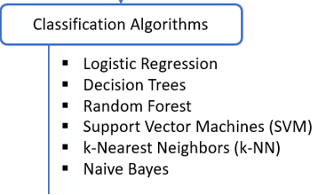
Classification
Classification Algorithms
Notes:
Classification Algorithms
Logistic Regression
Logistic regression is a simple yet powerful binary classification algorithm often used to predict probabilities of belonging to a specific class.
Application: Predicting the likelihood of a building meeting energy efficiency standards.
Decision Trees
Decision trees split data based on feature values, creating a model that is easy to interpret and visualize. This makes them popular in environmental applications where explainability is critical.
Application: Classifying waste types for efficient recycling.
Random Forest
Random forest builds multiple decision trees and combines their results, providing robustness and reducing the risk of overfitting. It’s useful for complex classification tasks in green tech.
Application: Forest health monitoring using satellite images.
Support Vector Machines (SVM)
Support Vector Machines create a hyperplane that best separates the classes. They are particularly effective in high-dimensional spaces, often used in environmental monitoring.
Application: Identifying pollution sources in water bodies.
K-Nearest Neighbors (KNN)
KNN classifies data points based on the majority class of their nearest neighbors. It's useful for applications that require simplicity and real-time decision-making.
Application: Species identification for biodiversity monitoring.
Naive Bayes
Naive Bayes classifiers assume independence between features and are fast and efficient, suitable for text classification and document tagging.
Application: Categorizing sustainability reports or environmental news.
Neural Networks
Neural networks are highly flexible and can model complex relationships. Although more resource-intensive, they are valuable for large-scale environmental applications.
Application: Solar panel defect classification in photovoltaic systems.

Slide 22
Classification
Classification Model Evaluation
Type of Regression Performance Metrics
Accuracy
Precision
Recall
F1 Score
ROC-AUC (Receiver Operating Characteristic - Area Under Curve)
Notes:
Evaluating the performance of a classification model is crucial to understanding its effectiveness in making predictions. Here are key metrics used in classification model evaluation, including accuracy, precision, recall, F1 score, and ROC-AUC, with definitions and examples.

Slide 23

Classification
Accuracy
Formula,
Example: In an environmental model predicting if a farm follows sustainable practices (yes or no), if the model predicts correctly 90 times out of 100, the accuracy is 90%.
Notes:
Accuracy measures the percentage of correctly predicted instances out of the total instances in the dataset. It’s a general metric but can be misleading when dealing with imbalanced data (where one class is significantly more common than the other).

Slide 24

Classification
Precision
Formula,
Example: For a recycling system that classifies items as "recyclable" or "non-recyclable," high precision ensures that items identified as "recyclable" truly belong in that category, reducing contamination in recycling processes.
Notes:
Precision measures the proportion of true positive predictions among all positive predictions made by the model. It’s crucial when the cost of a false positive is high, as it focuses on the correctness of the positive predictions.

Slide 25

Classification
Recall
Formula,
Example: In a model that detects forest fires, high recall ensures that most real fires are identified, even if it means some non-fires are also flagged. This minimizes the chance of missing real fire cases, which could lead to severe environmental harm.
Notes:
Recall (or sensitivity) measures the proportion of actual positive instances that the model correctly identified. It’s essential when the cost of a false negative is high, meaning missing a true positive has significant consequences.

Slide 26
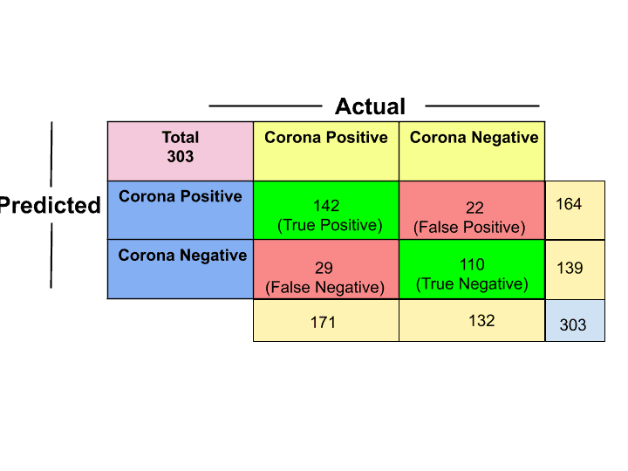
Confusion Matrix

Slide 27

Classification
F1 Score
Formula,
Example: For a model predicting endangered species, the F1 score balances recall (ensuring endangered species aren’t missed) and precision (avoiding unnecessary conservation efforts for non-endangered species).
Notes:
The F1 score is the harmonic mean of precision and recall, providing a balanced metric that accounts for both false positives and false negatives. It is especially useful for imbalanced datasets, where accuracy alone might not be representative of the model’s performance.

Slide 28
Classification
ROC-AUC (Receiver Operating Characteristic - Area Under Curve)
Formula,
True Positive Rate (Recall): Measures how well the model identifies true positives.
False Positive Rate: Measures how often the model incorrectly predicts a positive.
Example: For a green building classification model (efficient vs. inefficient), an AUC close to 1.0 indicates the model can reliably distinguish between energy-efficient and non-efficient buildings. AUC is particularly helpful when balancing precision and recall, or when deciding on an optimal threshold for classification.
Notes:
The ROC-AUC score evaluates the model’s ability to distinguish between classes across various threshold settings. The ROC curve plots the true positive rate (sensitivity) against the false positive rate, and the AUC (Area Under Curve) summarizes the overall performance. A higher AUC indicates better discriminatory ability.

Slide 29

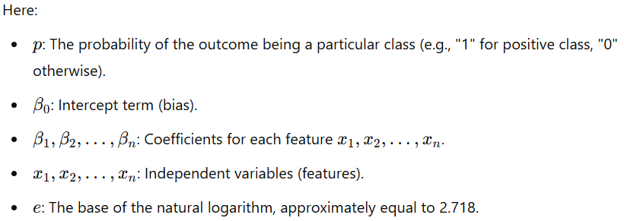
Understanding and Implementation of Logistic regression
Understanding of Logistic regression
The formula for Logistic Regression is,
Notes:
Logistic Regression is a powerful statistical method commonly used in classification tasks, including those in sustainability, where it can help predict outcomes such as the likelihood of adopting green technologies. In the context of sustainability and green technology, Logistic Regression provides a framework for understanding factors influencing the adoption of sustainable practices, renewable energy solutions, and eco-friendly technologies.
Logistic Regression is suitable for binary classification problems where the outcome is categorical, for instance, whether a technology is adopted (Yes/No) or if a company achieves a sustainability certification. The model estimates the probability of a certain event happening (e.g., the adoption of green technology) based on input variables. These variables might include financial metrics, energy costs, CO₂ emissions, governmental regulations, and other socioeconomic or environmental indicators.
Logistic Regression calculates the probability of a binary outcome by using the logistic (or sigmoid) function, which constrains the output to a range between 0 and 1. This probability is then interpreted as the likelihood of an outcome given the input features. For green technology, the Logistic Regression model might output the probability of a company adopting a renewable energy technology based on relevant indicators, enabling a classification of “likely to adopt” or “not likely to adopt.”

Slide 30
Understanding and Implementation of Logistic regression
Implementation of Logistic regression
Import Necessary Libraries
Load and Inspect the Dataset
Feature Selection and Target Variable
Split the Data into Training and Testing Sets
Initialize and Train the Logistic Regression Model
Evaluate the Model
Classroom Hands-on
3. Logistic regression
Notes:
Click Class Room Activity link (then implement and explain the code)
To implement Logistic Regression for predicting sustainability in green technologies, we'll create a model that can classify observations based on a dataset of green technology features. For instance, you might want to classify whether a particular energy source is "sustainable" or "not sustainable" based on various features like carbon emissions, energy output, resource renewability, etc.
This implementation will allow you to evaluate which features contribute the most to classifying green technologies as sustainable and assess the model's accuracy in making these predictions.

Slide 31
Lab Activity
Hands On
Lab 2
To create the Classifying Waste Types for Recycling (to classify them into different categories Plastic, Metal, Organic, etc) using classification algorithms

Slide 32


Let’s Start

Slide 33


Quiz
2. Which supervised learning algorithm is primarily used for continuous data prediction?
Logistic Regression
Linear Regression
K-Means Clustering
Naive Bayes
Answer: b
Linear Regression

Slide 34
Quiz
4. Which metric would be most appropriate to assess the performance of a classification model with imbalanced classes?
Accuracy
Mean Squared Error (MSE)
F1 Score
Adjusted R-squared
Answer: c
F1 Score

Slide 35
Thank You
Notes:
Thank You !!

